Slide 1


Warwick Data Science Society

Slide 2
Meet our team
WDSS

Slide 3
Mustard Systems Ltd
Sponsor of our Premier League Forecasting Competition
Experts in sports data analysis

Slide 4
Format of the competition
2
There will be 2 separate editions of the competition - in term 1 and in term 2
9
Competitors will be asked to submit 9 predictions this term
£1,500
Total prize pool this year is a whopping £1,500 + fast-track interview

Slide 5
Let’s sign up!
sports.wdss.io

Slide 6
Rules of the competition

Slide 7
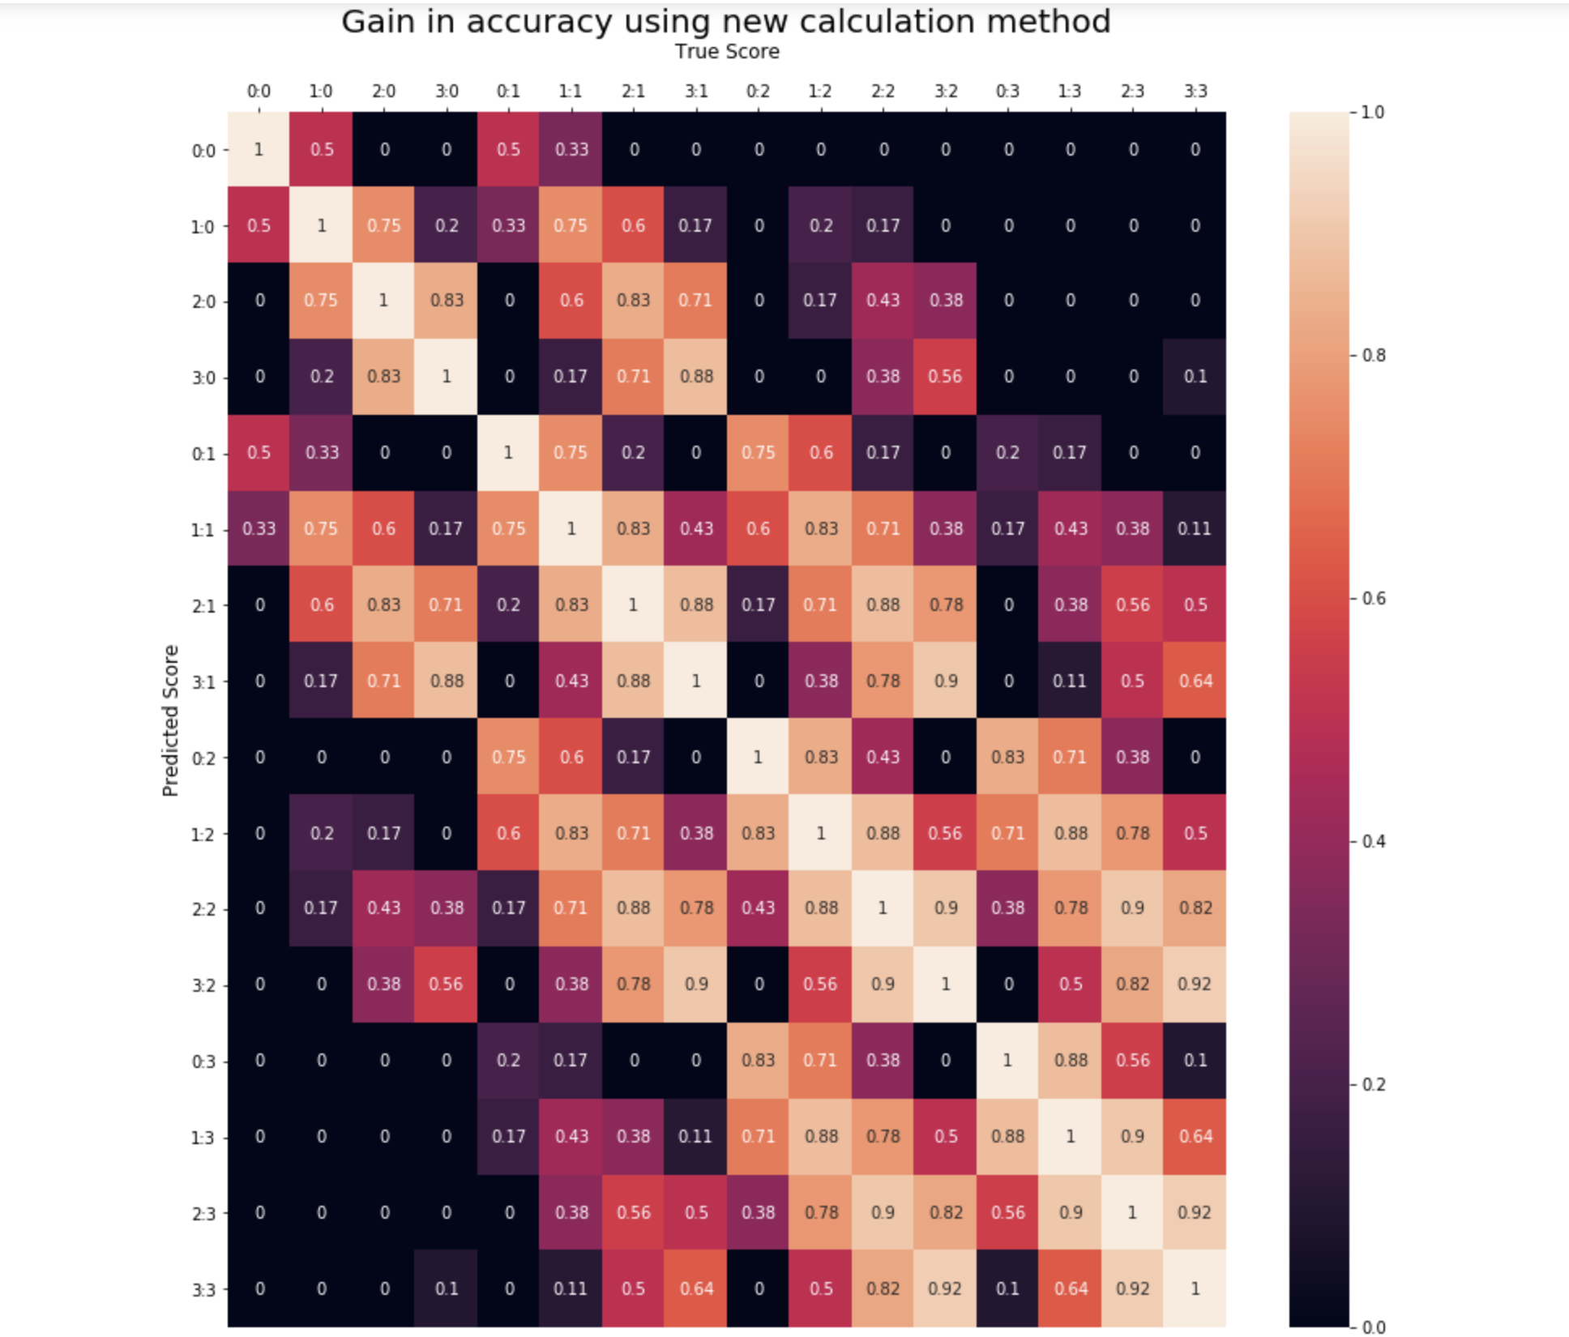

Slide 8
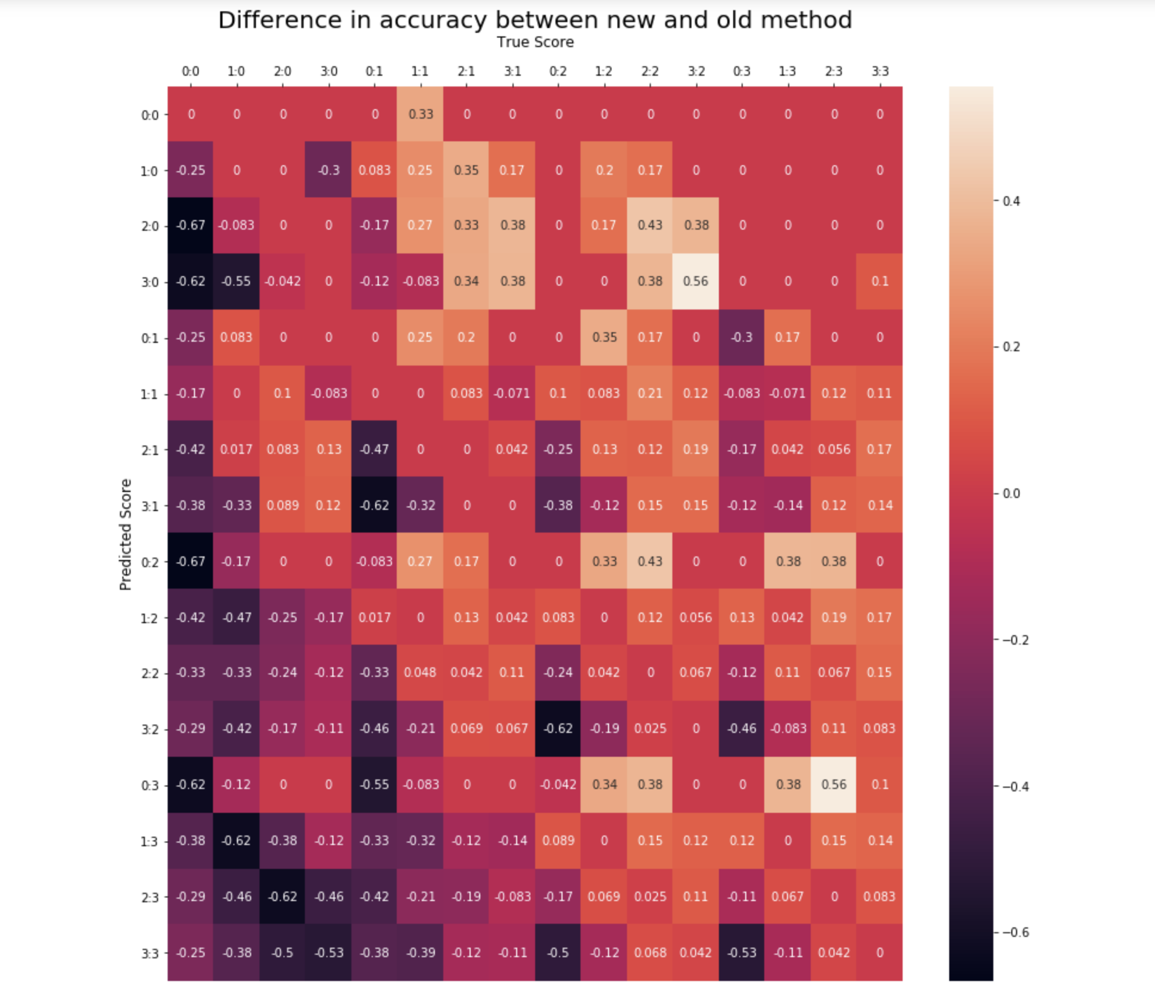

Slide 9
Example of the model

Slide 10
Q&A
Thank you for your attention

